Slide 1
ARTIFICIAL INTELLIGENCE
Game Playing
as Search
Minimax · Alpha-Beta Pruning · Imperfect Decision Making
3rd Year · AI Course

Slide 2
Learning Objectives
BY THE END OF THIS LECTURE
①
Model games as formal search problems with states, actions, and utilities
②
Explain adversarial search and why it differs from single-agent search
③
Implement the Minimax algorithm and analyse its complexity
④
Apply Alpha-Beta pruning to dramatically reduce the search space
⑤
Reason about decision-making under uncertainty and imperfect information

Slide 3
What Is a Game in AI?
PART 1 · GAME PLAYING AS SEARCH
Formal Components
Classic Examples
States:
Complete description of the board / game at any point in time
♟
Chess
35M states per move
Initial State:
The starting configuration before any moves are made
⬡
Go
~250 branches
Players:
Agents taking turns — usually MAX and MIN
✕○
Tic-Tac-Toe
Actions:
The legal moves available in a given state
Simple 3×3 grid
⬤
Checkers
Transition Model:
Result(s, a): state reached after applying action a in state s
Solved in 2007
🎲
Backgammon
Terminal Test:
Checks whether the game is over (win, loss, draw)
Stochastic (dice)
Utility Function:
Numeric payoff for each player at a terminal state
🃏
Poker
Imperfect info

Slide 4
Types of Games
PART 1 · GAME PLAYING AS SEARCH
Deterministic vs. Stochastic
Deterministic
Stochastic
Actions have certain, predictable outcomes
vs
Random elements (dice, shuffled cards) introduce chance
e.g. Chess, Go, Tic-Tac-Toe
e.g. Backgammon, Solitaire
Perfect vs. Imperfect Information
Perfect Info
Imperfect Info
All players can see the entire game state at all times
vs
Some information (e.g. cards) is hidden from opponents
e.g. Chess, Checkers, Go
e.g. Poker, Stratego
Zero-Sum vs. Non-Zero-Sum
Zero-Sum
Non-Zero-Sum
One player's gain equals the other's loss — pure competition
vs
Both players can win or lose; collaboration is possible
e.g. Chess, Checkers
e.g. Negotiation, Cooperation

Slide 5
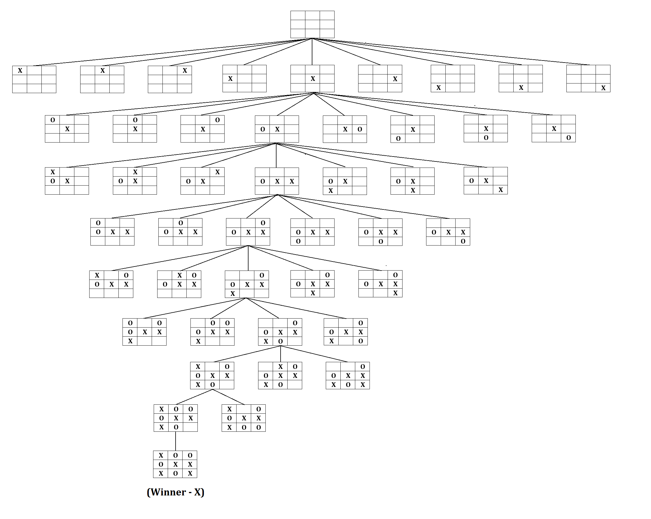
Game as a Search Tree
PART 1 · GAME PLAYING AS SEARCH
Nodes
Tic-Tac-Toe Search Tree
Represent individual game states
Edges
Represent legal actions / moves taken
Root
The current game state we're evaluating
Leaves
Terminal states (game over conditions)
Utility Values
Numeric payoffs assigned to terminal states

Slide 6
Why Traditional Search Is Not Enough
PART 1 · GAME PLAYING AS SEARCH
Single-Agent Search
Adversarial Search (Games)
✓ Environment is fully cooperative
✗ An opponent actively works against you
✓ Only one decision-maker
✗ Multiple competing decision-makers
✓ Optimise toward a fixed goal
✗ Must account for all opponent responses
✓ State transitions are predictable
✗ Opponent moves change the environment
✓ No adversary to account for
✗ Best-case analysis is insufficient
✓ A* / BFS / DFS are sufficient
✗ Need to reason about worst-case
→ This leads us to Adversarial Search — planning against a rational opponent

Slide 7
The Minimax Principle
PART 2 · MINIMAX ALGORITHM
Adversarial Assumption
Two players — MAX and MIN — alternate moves. MAX tries to maximise utility; MIN tries to minimise it.
Critically: we assume the opponent always plays optimally. This worst-case assumption guarantees a safe strategy.
MAX (Maximising Player)
MIN (Minimising Player)
Goal:
Choose the move that leads to the highest guaranteed utility — the best outcome assuming the opponent also plays perfectly.
Goal:
Choose the move that leads to the lowest possible utility for MAX — the opponent always makes things as hard as possible.
Strategy: pick max of children's values
Strategy: pick min of children's values
V(s) = max V(s')
V(s) = min V(s')
s' ∈ successors(s)
s' ∈ successors(s)
This recursive, back-propagated reasoning is the foundation of all game-playing AI

Slide 8
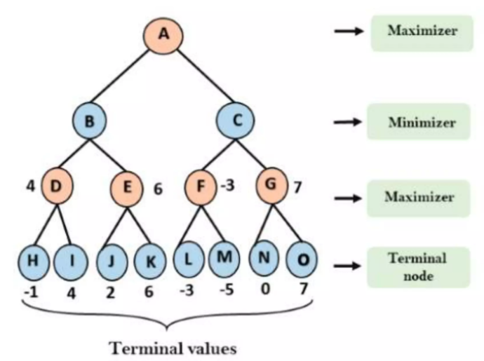
Minimax Tree — Worked Example
PART 2 · MINIMAX ALGORITHM
Evaluate all leaf nodes (terminal utilities): -1, 4, 2, 6, -3, ….
Positive means maximizer wins, negative means minimizer wins
Maximizer chooses the max of the children of each node
Minimizer chooses the min of the children of each node
Keep going until you reach the root
Key Insight: MAX always picks the branch that leads to its highest guaranteed payoff — even if the opponent plays perfectly against it

Slide 9
Minimax — Formal Definition & Pseudocode
PART 2 · MINIMAX ALGORITHM
Formal Definition
Pseudocode
V(s) = Utility(s)
if s is terminal
function MINIMAX(state):
if TERMINAL(state):
return UTILITY(state)
if MAX's turn:
value = −∞
for each action a:
child = RESULT(state, a)
value = max(value,
MINIMAX(child))
return value
else: // MIN's turn
value = +∞
for each action a:
child = RESULT(state, a)
value = min(value,
MINIMAX(child))
return value
V(s) = max V(s')
if s is a MAX node
V(s) = min V(s')
if s is a MIN node
Recursive:
Each call explores one level deeper
Backpropagation:
Values bubble up from leaves to root
Optimality:
Returns optimal move assuming rational opponent
Completeness:
Will find a solution if tree is finite

Slide 10
Complexity & Depth-Limited Search
PART 2 · MINIMAX ALGORITHM
Time Complexity of Full Minimax
O(b
m
)
b = branching factor · m = maximum depth of tree
Game
b
m
bᵐ estimate
Verdict
Tic-Tac-Toe
~4
9
≈ 4⁹ = 262,144
✓ Feasible
Chess
~35
80 (max)
≈ 35⁸⁰ ≈ astronomical
✗ Infeasible — depth limited to ~8
Go
~250
150 (max)
≈ 250¹⁵⁰ — beyond any computer
✗ Requires MCTS + Deep RL
Solution: Depth-Limited Search → Cut the tree at depth d, then use an evaluation function Eval(s) ≈ Utility(s) to estimate terminal values without reaching true leaves

Slide 11
Evaluation Functions
PART 2 · MINIMAX ALGORITHM
When full search is impossible, we use an evaluation function Eval(s) to estimate the utility of a non-terminal state. A good evaluation function is the difference between winning and losing in real-world games.
Correlation with winning
Speed of computation
Smooth and consistent
The function must reflect the true probability of winning. A state that's clearly winning should score much higher than a losing one.
Called millions of times during search, so it must be fast — typically O(1) or O(n) at most. A slow eval function defeats the purpose.
Small positional differences should produce small value differences; large differences should produce large ones. Avoid discontinuities.
Chess Evaluation Function — Common Features
Material Count:
Sum piece values (pawn=1, knight/bishop=3, rook=5, queen=9). Most important factor — being up material almost always wins.
Piece Mobility:
Number of legal moves available. More options = more control and flexibility; restricted pieces are weaker pieces.
King Safety:
Penalise open files near the king, reward castled positions and pawn shields. A vulnerable king loses quickly.
Pawn Structure:
Penalise doubled, isolated, or backward pawns; reward passed pawns near promotion. Pawns define the game's skeleton.
Centre Control:
Pieces controlling the centre have greater reach. Extra weight for pawns and pieces on d4, d5, e4, e5 squares.

Slide 12
Alpha-Beta Pruning — Motivation
PART 3 · ALPHA-BETA PRUNING
Minimax is correct but brutally expensive — it visits every node in the game tree. Yet many branches cannot possibly affect the final decision. Alpha-Beta pruning skips them, saving enormous amounts of computation.
Intuitive Analogy
Imagine you're choosing a vacation. You've found a great deal at $500. Now you're checking a second agency whose prices start at $700. You don't need to look at their full catalog — you already know the first option is better. Alpha-Beta does exactly this: once a branch can't beat the current best, stop exploring it.
α — Alpha
β — Beta
Best value MAX can guarantee along the current path
Best value MIN can guarantee along the current path
MAX's lower bound — MAX will never accept less than α
MIN's upper bound — MIN will never allow more than β
Prune (skip) a branch when α ≥ β — the current path can never lead to a better result for the player whose turn it is

Slide 13
Alpha-Beta — Step-by-Step Example & Pseudocode
PART 3 · ALPHA-BETA PRUNING
Trace — tree with α/β propagation:
Pseudocode
Init
Root MAX node: α = −∞, β = +∞
function ALPHABETA(s, α, β):
if TERMINAL(s):
return UTILITY(s)
if MAX's turn:
v = −∞
for each action a:
v = max(v,
ALPHABETA(result(s,a), α, β))
α = max(α, v)
if α ≥ β: break // prune!
return v
else: // MIN's turn
v = +∞
for each action a:
v = min(v,
ALPHABETA(result(s,a), α, β))
β = min(β, v)
if β ≤ α: break // prune!
return v
Step 1
Explore left MIN subtree. First leaf = 3. MIN's best ≤ 3; α stays −∞
Step 2
Second leaf = 5. Still worse for MIN. MIN's value still 3.
Step 3
Third leaf = 2. MIN picks 2. Back at MAX: α = max(−∞, 2) = 2.
Step 4
Explore right MIN subtree. First leaf = 9. MAX's α = 2.
Step 5
MIN can guarantee ≤ 9. But we already have 2 for MAX. β = 9 ≥ α = 2; continue.
Step 6
Second leaf = 1. MIN picks min(9,1) = 1. Now β = 1 < α = 2. PRUNE!
Result
MAX returns 2 (left branch). Third leaf of right subtree NEVER visited.

Slide 14
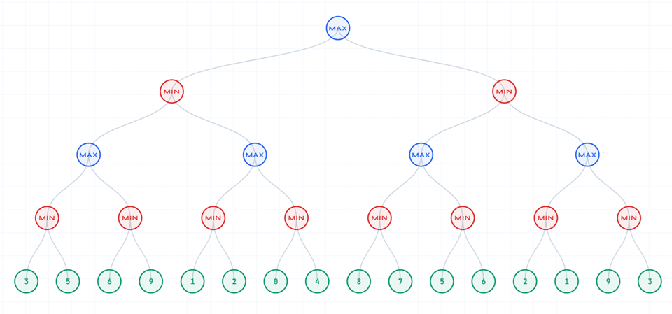

Slide 15
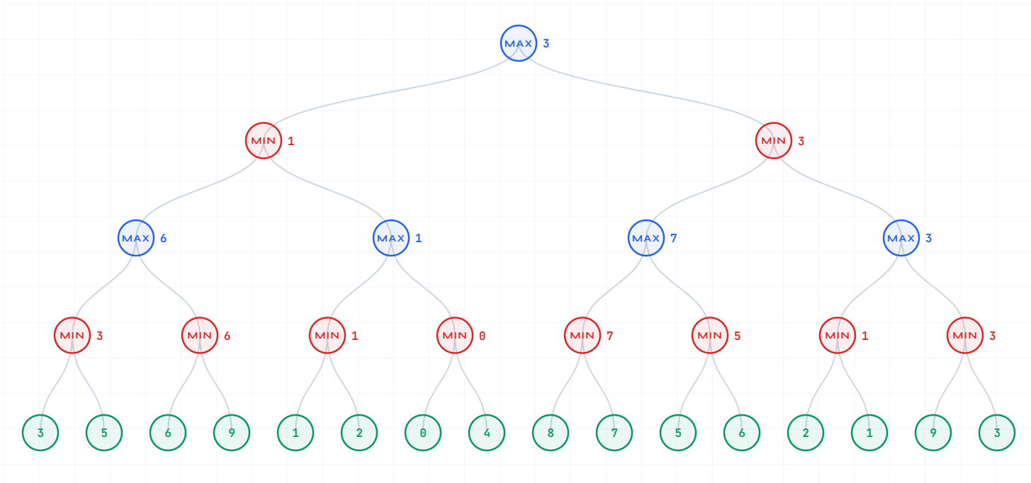

Slide 17
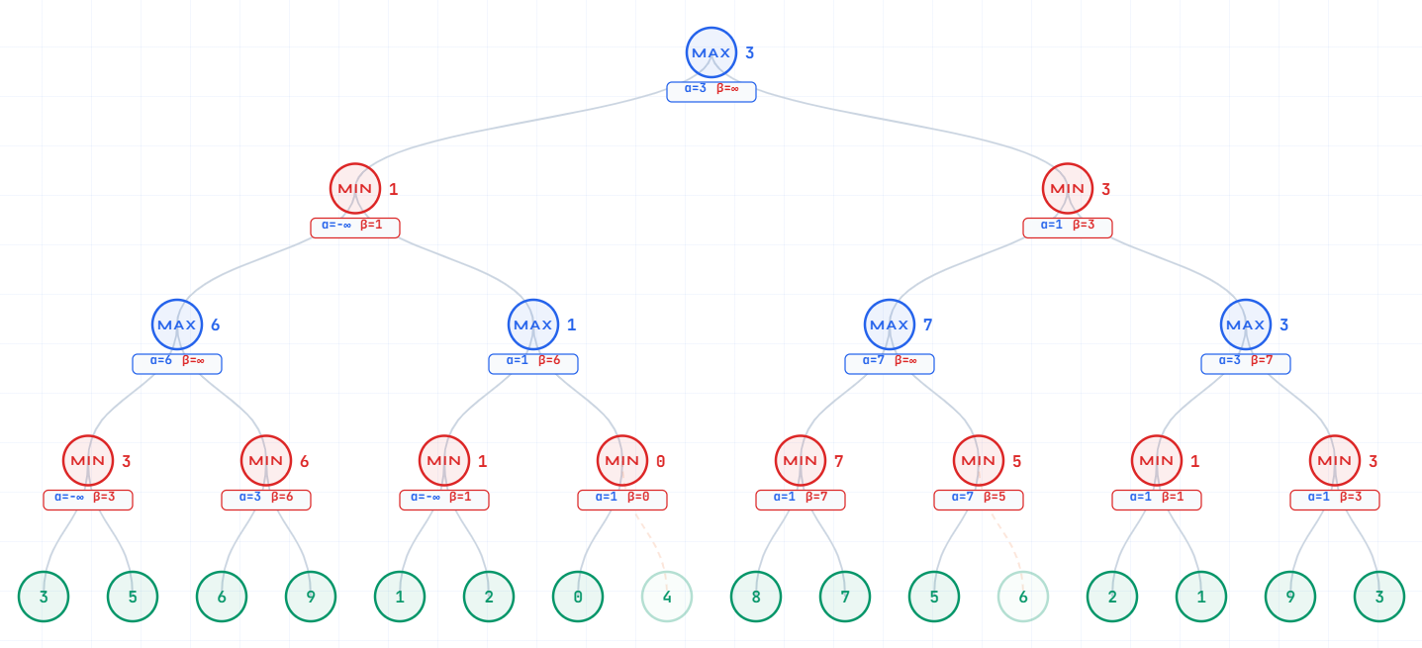

Slide 18
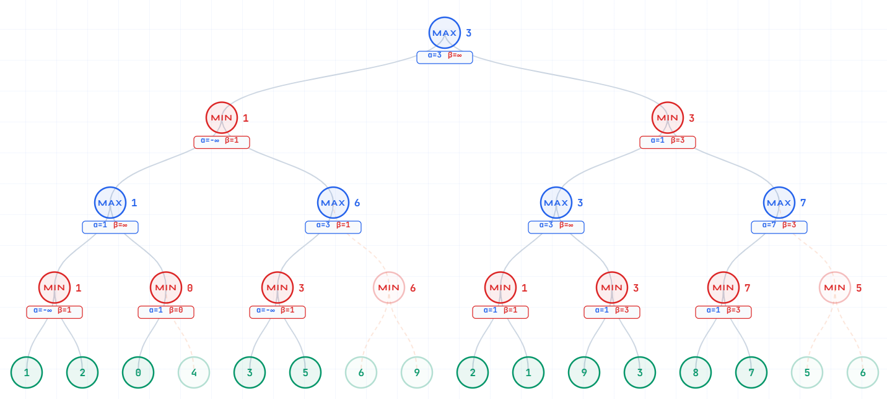

Slide 19
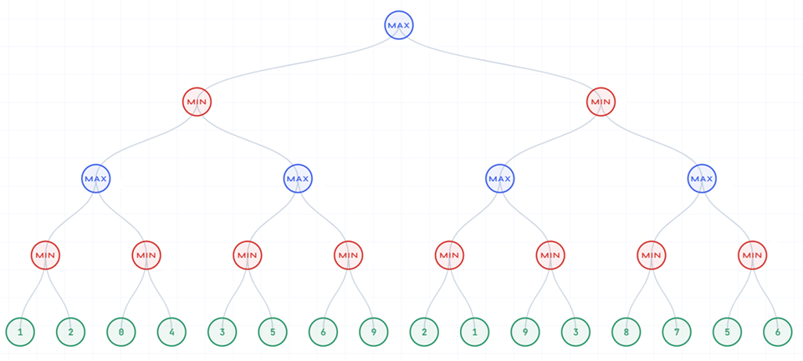

Slide 20
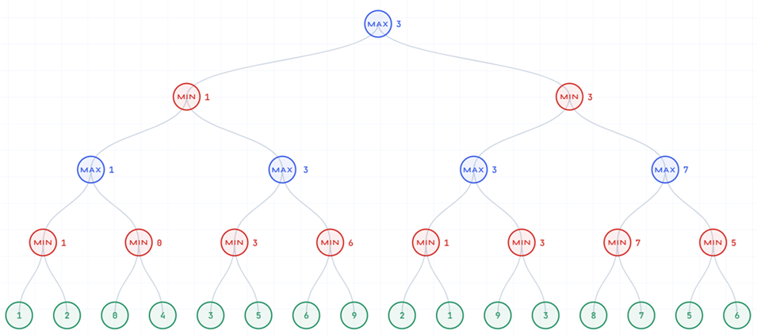

Slide 21
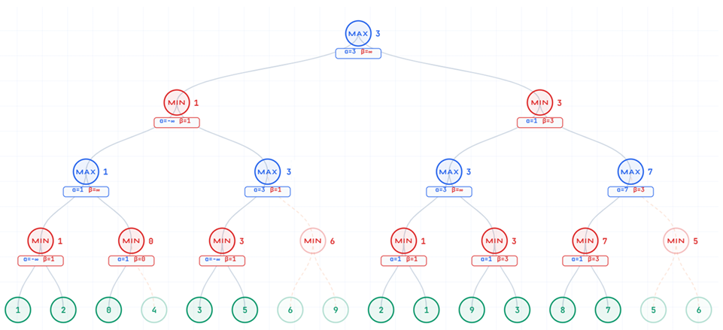

Slide 22
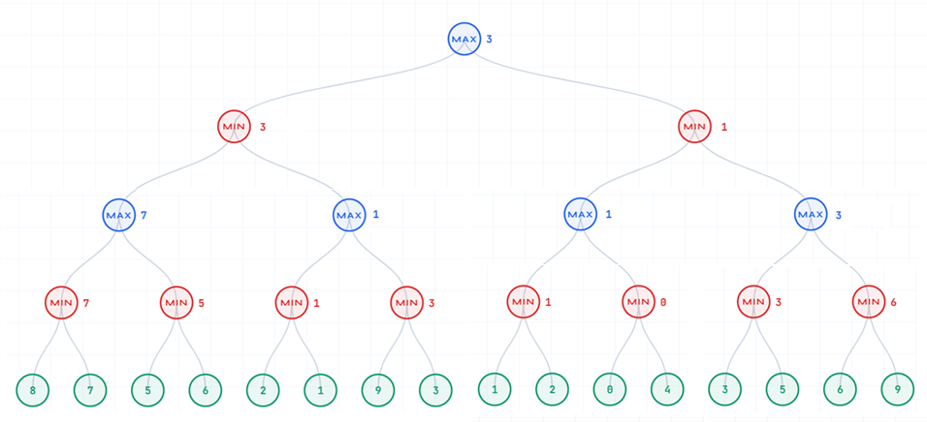

Slide 23
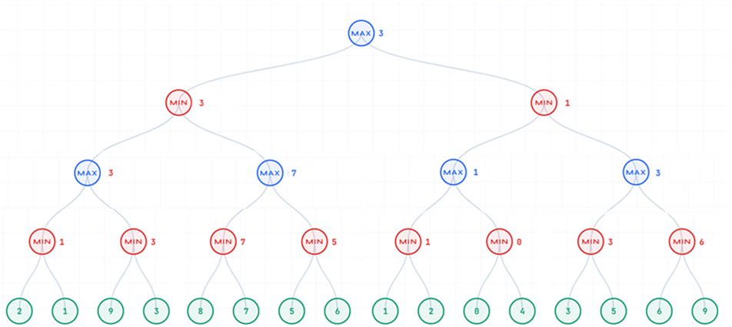

Slide 24
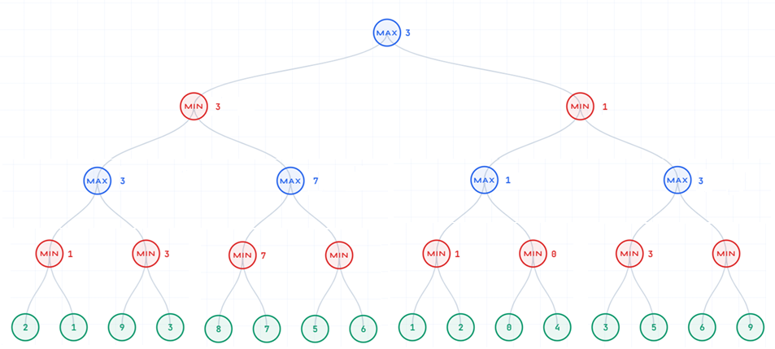

Slide 25
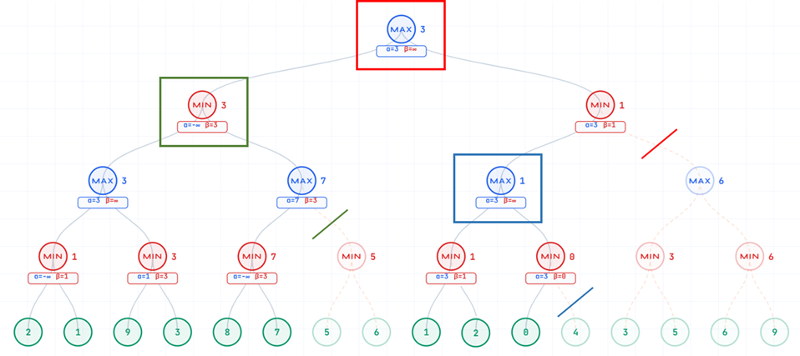

Slide 26
Alpha-Beta Complexity & Move Ordering
PART 3 · ALPHA-BETA PRUNING
Worst Case
Best Case
Average Case
m
m/2
3m/4
O(b
)
O(b
)
O(b
)
No pruning occurs. Identical to full Minimax — all nodes visited. Happens when moves are ordered worst-first.
Optimal move ordering — always examine the best move first. Effective branching factor becomes √b, effectively doubling search depth.
Random ordering. Typically achieves significant pruning in practice. Chess depth effectively increases by 50–100%.
Move Ordering — Why It Matters So Much
Better move ordering leads to more pruning. In chess, examining the best move first can cut the search space from b^m to b^(m/2) — that's a HUGE improvement. Standard techniques:
• Captures First:
Winning captures examined before quiet moves; they tend to be good moves.
• Killer Moves:
Store moves that caused pruning at same depth — try them again in siblings.
• History Heuristic:
Track how often each move caused a cut; sort by historical success rate.
• Iterative Deepening:
Search depth d-1 first; use best move found as first move at depth d.

Slide 27
Imperfect Decision Making — Stochastic Games
PART 4 · IMPERFECT DECISION MAKING
Minimax assumes a deterministic world with a rational opponent. But many real games involve randomness (dice, card shuffles) or hidden information. We need extensions to handle these.
When Minimax Assumptions Break
Stochastic Outcomes
Imperfect Information
Non-rational Opponent
Dice, coin flips, card draws. The same action can lead to different states. e.g. Backgammon dice.
Cards in hand are hidden. Opponent's resources unknown. e.g. Poker, Stratego.
Real opponents make mistakes. Pure worst-case analysis misses winning opportunities.
Expectiminimax — Handling Chance Nodes
Tree now has three node types: MAX (our turn), MIN (opponent's turn), and CHANCE (random event like a dice roll).
Dice Example:
P(roll=1) = 0.5 → child value = 10 P(roll=2) = 0.5 → child value = 0 E[V] = 0.5 × 10 + 0.5 × 0 = 5
For CHANCE nodes, compute expected value:
V(s) = Σ P(outcome) × V(child)

Slide 28
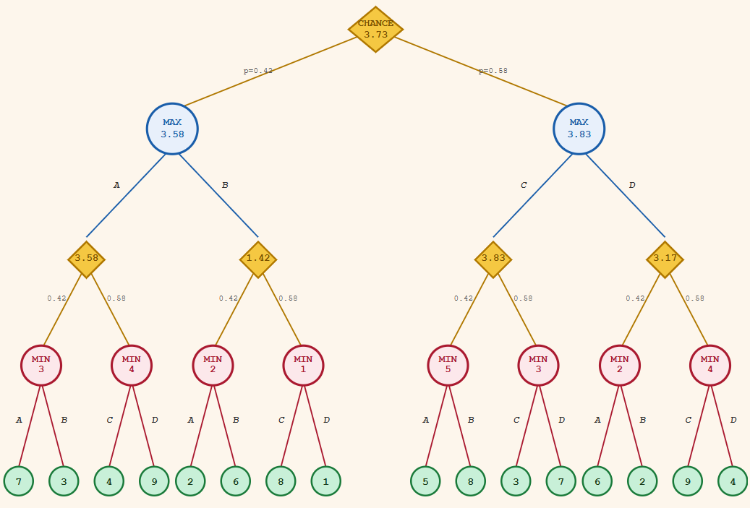
MAX rolls the dice
MAX makes a move
Available plays after this dice roll
Available plays after this dice roll
MIN rolls the dice
MIN makes a move

Slide 29
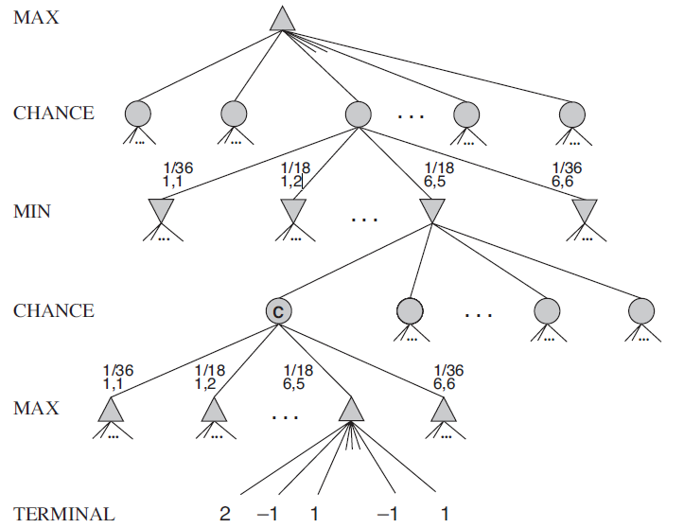
…
MAX makes a move
Assuming MAX rolled the dice already
MIN rolls the dice
The probability of each dice outcome
MIN makes a move
MAX rolls the dice
MAX makes a move

Slide 30
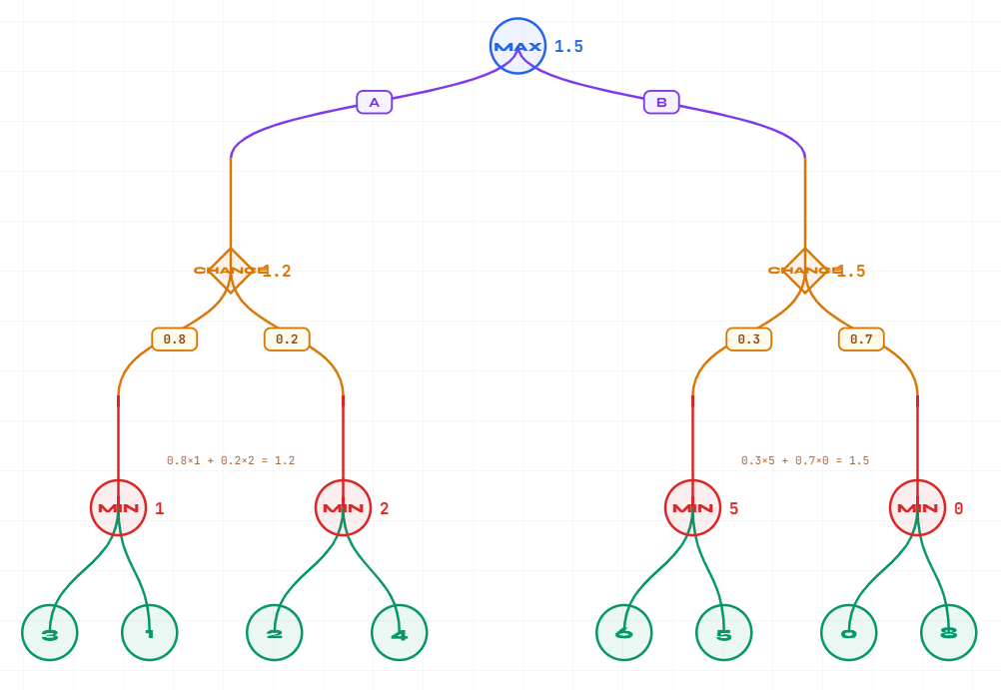
…
MAX makes a move
Assuming MAX rolled the dice already
MIN rolls the dice
MIN makes a move

Slide 31
Imperfect Information & Mixed Strategies
PART 4 · IMPERFECT DECISION MAKING
Imperfect Information
Mixed Strategies & Nash Equilibrium
In games like Poker or Battleships, we do not have full visibility of the game state. This fundamentally changes strategy.
The agent must maintain belief states — probability distributions over possible opponent states — and update them as new information arrives (Bayesian updating).
A deterministic strategy is exploitable — a smart opponent will learn and beat it. The solution is to randomise.
Rock-Paper-Scissors — Classic Example
✗ Always Rock:
Opponent plays Paper → always wins
✗ Always Paper:
Opponent plays Scissors → always wins
Belief States:
Track a distribution P(hidden state | observed evidence) updated each turn
Information Sets:
Group states the player cannot distinguish — act over the whole set
✗ Always Scissors:
Opponent plays Rock → always wins
Counterfactual Regret:
Minimise regret across histories — used in modern Poker AI (Libratus)
✓ Random 1/3 each:
No exploitable pattern → Nash Equilibrium!
POMDP Formulation:
Partially Observable Markov Decision Process — principled framework
Nash Equilibrium
Examples: Poker, Stratego, Battleships, Magic: The Gathering
A set of strategies where no player can improve by unilaterally changing strategy. In zero-sum 2-player games, this is the optimal mixed strategy — both players randomise optimally and neither can do better.
Also requires: Game Theory · Bayesian Updating · Probabilistic Reasoning

Slide 32
Bounded Rationality & Real Opponents
PART 4 · IMPERFECT DECISION MAKING
Minimax assumes the opponent is perfectly rational — always making the best possible move. In practice, opponents are human, use heuristics, or are weak AI agents. Modelling this can unlock significantly stronger play.
Why Opponents Deviate from Optimal Play
How AI Can Exploit This
▸ Time pressure forces quick, suboptimal decisions
▸ Limit search depth to model opponent's horizon (bounded minimax)
▸ Cognitive limits — human working memory is finite (~7 items)
▸ Use noisy/probabilistic move models: P(opponent plays move) ∝ quality
▸ Pattern-based play learned from experience, not exhaustive analysis
▸ Exploit known human tendencies (e.g. centre openings in chess)
▸ Emotional state affects decision quality (tilt, overconfidence)
▸ Play objectively weaker moves that confuse or trap specific opponents
▸ Incomplete knowledge of openings, endgames, or tactics
▸ Opponent modelling with RL or Bayesian inference on play history

Slide 33
Modern Game AI — Beyond Minimax
PART 4 · IMPERFECT DECISION MAKING
Classical minimax with alpha-beta dominated game AI for decades. Modern AI has broken through the computational barriers that limited classical methods — achieving superhuman play in even the most complex games.
MCTS
Monte Carlo Tree Search
Instead of evaluating all branches, simulate random playouts from promising states and back-propagate win rates. Combines exploration with exploitation (UCB formula). Key to AlphaGo.
✓ Works without evaluation function, handles huge branching factors ✗ Requires many simulations to converge; slow for real-time games
DNN
Deep Neural Networks
Learn position evaluation from millions of games rather than hand-crafting features. Convolutional networks for board games (vision-like); transformer-based for sequential games.
✓ Rich position evaluation, detects complex patterns ✗ Huge training data requirements; black-box decisions
RL
Reinforcement Learning
Agent learns by playing against itself (self-play) and receiving win/loss rewards. No human data needed. AlphaZero learned chess, Go and shogi from scratch in hours.
✓ Self-improving, no expert data needed, discovers novel strategies ✗ Unstable training, reward engineering is hard, compute-intensive

Slide 34
Strengths & Weaknesses — Algorithm Comparison
SUMMARY
Minimax
Alpha-Beta Pruning
✓ Strengths
✓ Strengths
· Optimal for deterministic, perfect-info games
· Reduces to O(b^(m/2)) in best case
· Simple to implement and reason about
· Same optimal result as Minimax
· Guarantees best worst-case outcome
· Large practical speedup with move ordering
✗ Weaknesses
✗ Weaknesses
· O(bᵐ) — exponential in depth and branching
· Still exponential in worst case
· Cannot handle stochastic environments
· Benefit depends heavily on move ordering
Expectiminimax
MCTS + Deep RL
· Assumes opponent rationality — fails vs humans
· Pure classical approach — no learning
✓ Strengths
✓ Strengths
· Correctly handles random events (dice, cards)
· Handles massive search spaces (Go, Chess)
· Generalises Minimax naturally
· No need for hand-crafted evaluation functions
· Provably correct under stated assumptions
· Self-improvement through self-play (AlphaZero)
✗ Weaknesses
✗ Weaknesses
· Even more expensive: b^m × number of outcomes
· Requires enormous compute and data to train
· Requires known probabilities
· Black-box: difficult to interpret decisions
· Evaluation function must be linear in utilities
· Overkill for simple or well-solved games

Slide 35
Key Takeaways
01
Games are formalised as search trees with states, players, actions, and utility functions.
02
Minimax guarantees optimal play against a rational opponent but is exponentially expensive.
03
Alpha-Beta pruning achieves the same result while exploring only O(b^(m/2)) nodes in the best case.
04
Depth-limited search + evaluation functions make Minimax practical for real games.
05
Stochastic games need Expectiminimax; imperfect information requires probabilistic and game-theoretic reasoning.
06
Modern AI (MCTS, Deep RL, AlphaZero) overcomes classical limits, achieving superhuman performance.
Artificial Intelligence · Game Playing as Search · 3rd Year

